Slide 1

Giving Back Enterprises, LLC “Promoting Positive Results in the Community!”
Saundra Howard-McGee, M.S., CSA
Chief Executive Officer
Freddie L. Scott, Chief Operating Partner

Slide 2
THE MISSION
To empower professional athletes and organizations to “give back”
To strengthen the lives of youth and adults in our communities
To bring resources to critically underserved individuals in communities

Slide 3
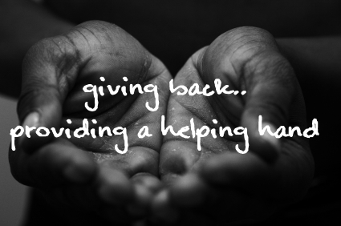

Slide 4
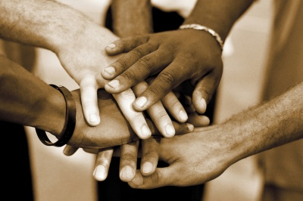
THE BELIEF
Business exists to serve the needs of society
And make a difference in our community!

Slide 5
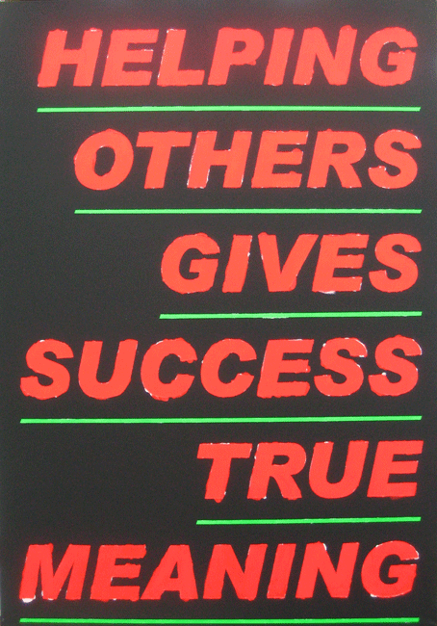
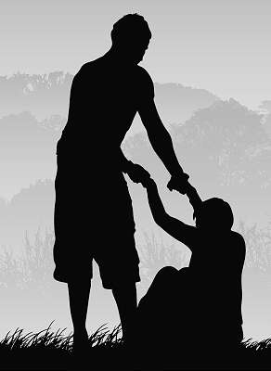

Slide 6
A Unique Partnership
Saundra Howard-McGee, retired Executive Director of Detroit Public Schools and
Freddie L. Scott, former Detroit Lions Wide Receiver
Have joined together to help professional athletes and organizations “give back” to communities

Slide 7
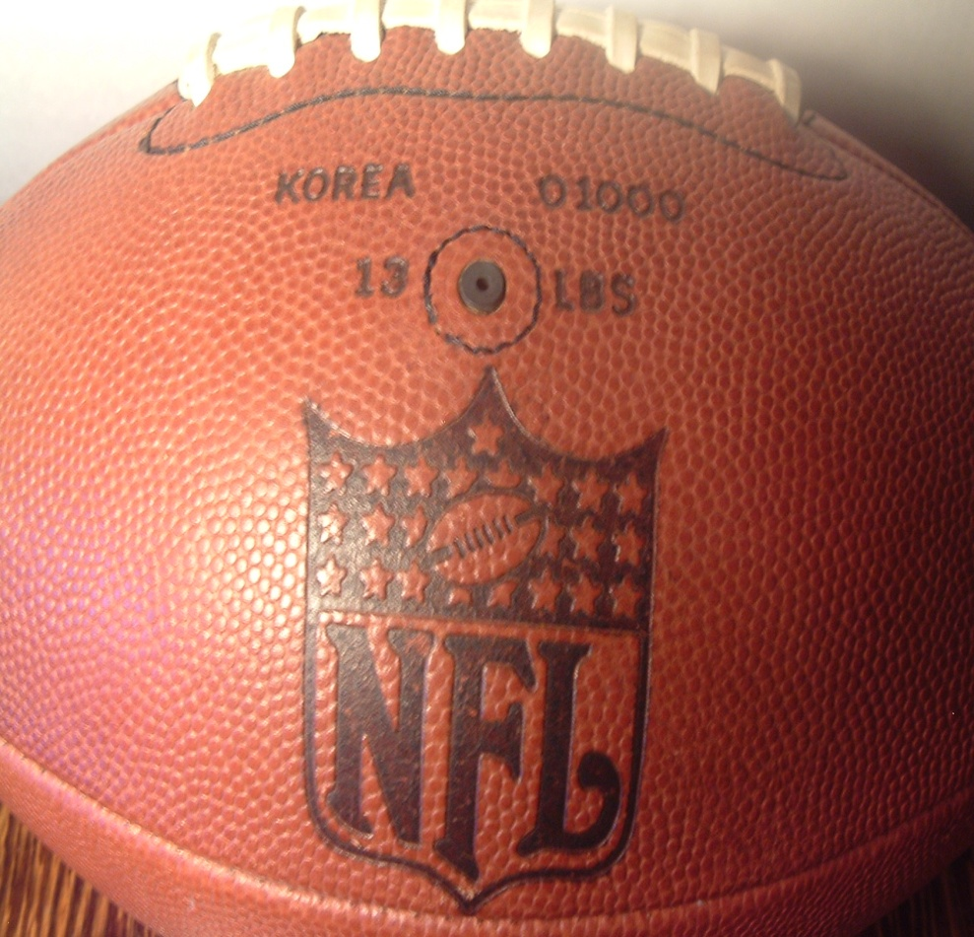

NFL + EDUCATION = PARTNERS WORKING TOGETHER TO “GIVE BACK”

Slide 8

Giving Back Enterprises:
Provides professional philanthropy and consultant services
That help build and target resources toward a more viable community!

Slide 9
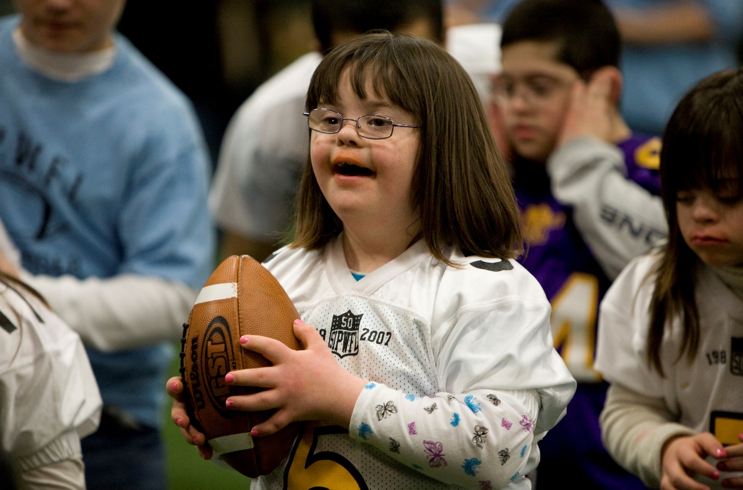

Slide 10
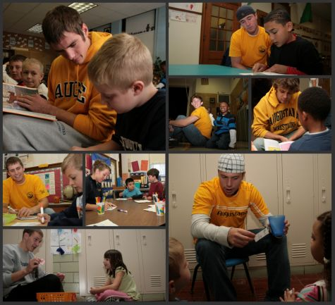
GIVING BACK!!

Slide 11

GBE’s SERVICES
Private Foundation Set-Up
Consultant Services
Strategic Partnerships
1st Consultation is FREE

Slide 12
GBE’s SERVICES Continued
Program and Fund Development
Grant Development and Training
Entrepreneurship and Executive Coaching
1st Consultation - FREE

Slide 13
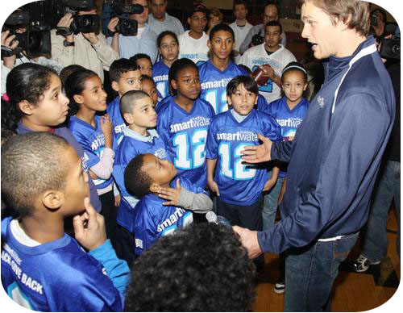
TOUCH LIVES!!

Slide 14

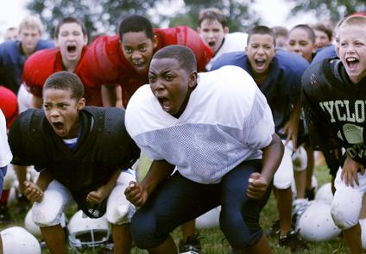
AREAS WHERE YOU CAN HELP
HEALTH, SPORTS AND RECREATION

Slide 15
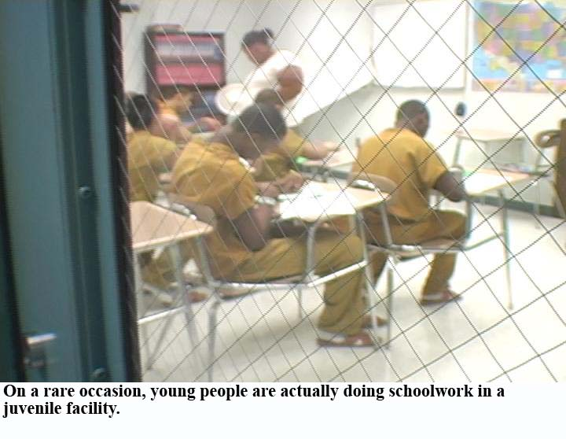

AREAS WHERE YOU CAN HELP
INCARCERATED YOUTH EDUCATION
ADULT ILLITERACY

Slide 16


Slide 17
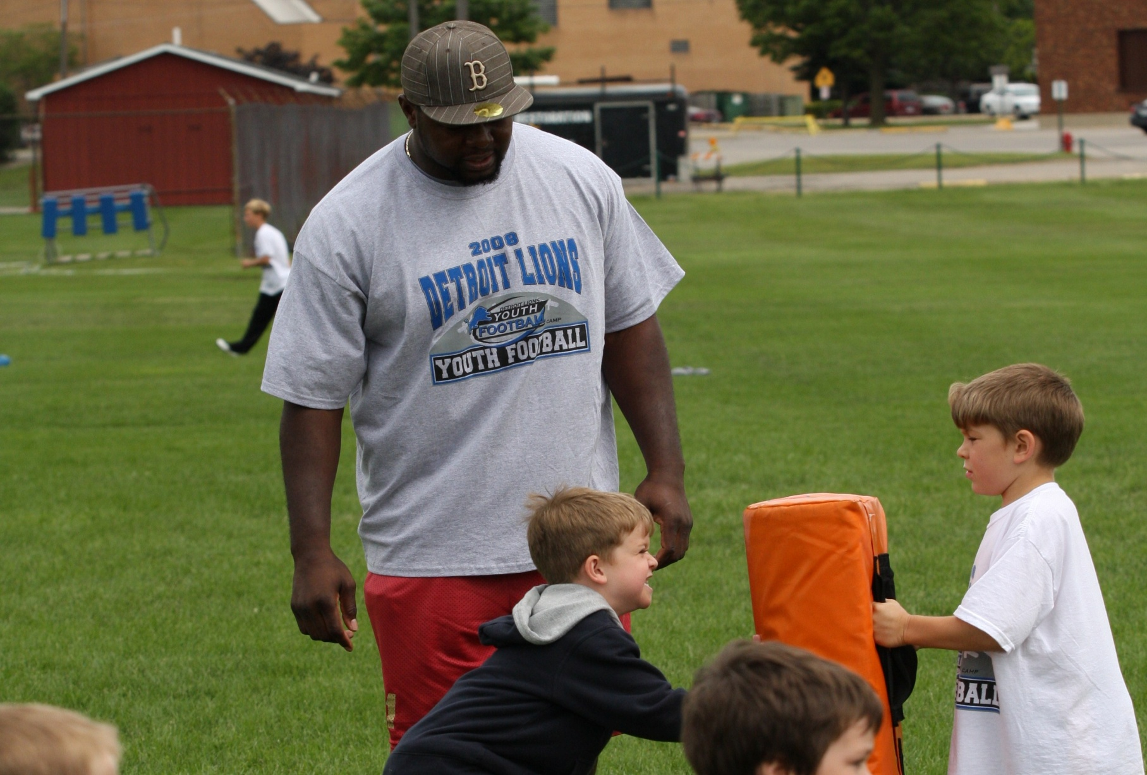

Slide 18

“Where Do You Want to Give Back?”
Giving Back Enterprises will help direct resources to your area of interest
Giving Back Enterprises will help coordinate your activities to assist individuals in need

Slide 19
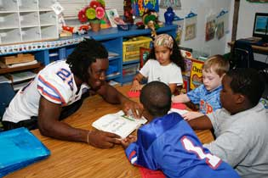
MAKE A DIFFERENCE!!

Slide 20
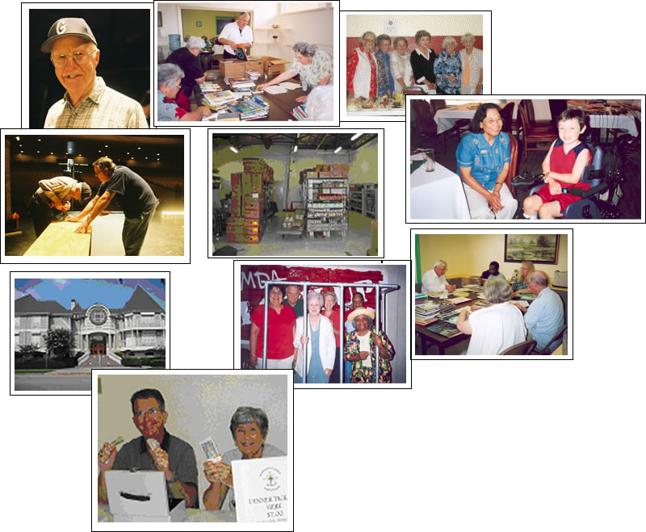
SUPPORT COMMUNITIES!

Slide 21

YOUR EFFORTS COUNT!!

Slide 22


Slide 23
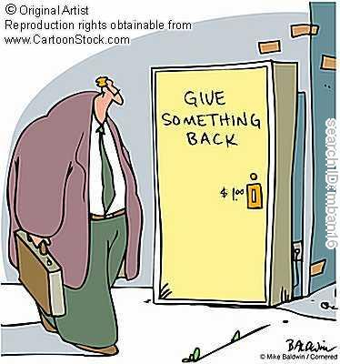
MAKE A POSITIVE IMPACT!

Slide 24
Giving Back Enterprises
SIGN UP TODAY
FOR YOUR
FREE
CONSULTATION!
Let’s work together to
promote positive results
in the community !
l

